Slide 1
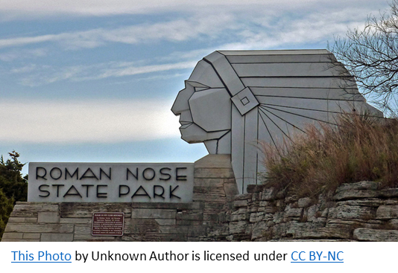

Roman Nose State Park Marketing Plan: Guided Hikes
Raveena Bhakta
Southwestern Oklahoma State University

Slide 2
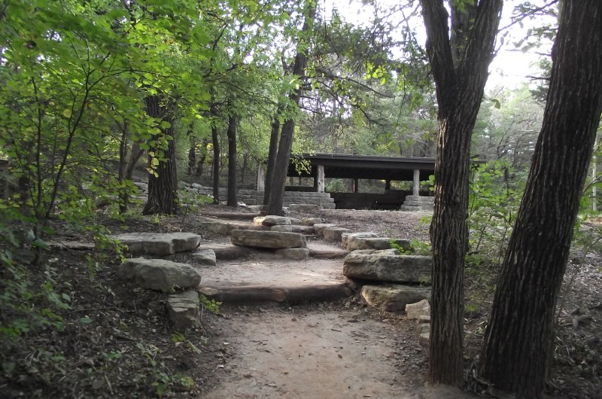
Description of Project
Guided hikes on a regular basis, i.e. Monthly
Give visitors an option to schedule these as well
Target Audience:
First-time visitors
Families/groups
This Photo by Unknown Author is licensed under CC BY-NC-ND

Slide 3
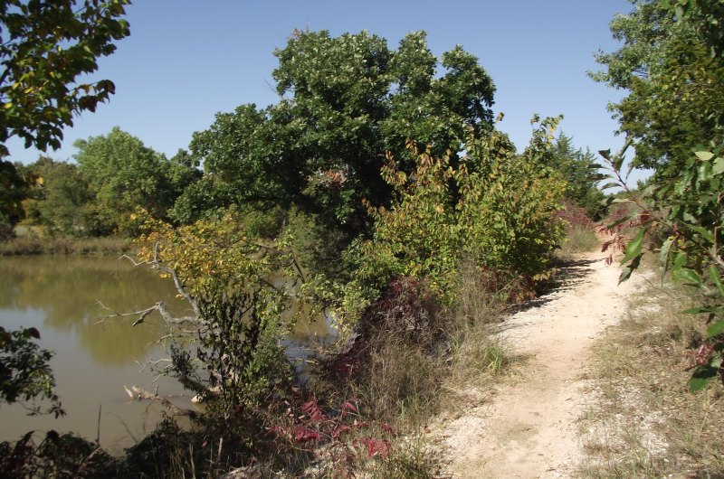
Product Strategy
From a guided hike visitors will be able to:
Explore more places than on their own
Learn about the park’s culture and history
Witness all of the natural attractions and wildlife
Focus on and promote:
Fitness
Exploration
Mindfulness
This Photo by Unknown Author is licensed under CC BY-NC-ND

Slide 4



Hiking Club
Could be organized to give people:
Sense of community
Chance to know others
Enjoy hiking as a group
Facebook Group Page
Promote the club
Get feedback

Slide 5

Marathons
Venue: The Park’s hiking trails
Groups or organizations with a cause they would like to support
The Park can have its own marathon-like event
With challenges people can try to accomplish
Maybe prizes too

Slide 6
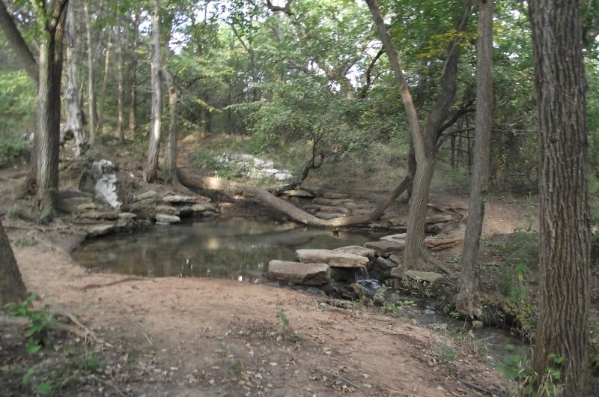

Challenges
Guides
Scheduling and planning
Weather
Public interest
This Photo by Unknown Author is licensed under CC BY-NC-ND

Slide 7
Thank you!
This Photo by Unknown Author is licensed under CC BY-NC

